Slide 1


INTRODUCTION TO
HTML CSS JAVASCRIPT
S.AISHA BANU
24524U18005
KARAN ARTS AND SCIENCE COLLEGE
THIRUVANNAMALAI.

Slide 2


INTRODUCTION TO WEB DEVELOPMENT
Web development is the process of creating and maintaining websites. It covers everything from designing how a site
looks to making it work
smoothly and securely

Slide 3
HTML
INTRODUCTION:
r HTML stand for hypertext markup language
r HTML is the standard markup language for creating webpage
r HTML describes the structure of a web
page

Slide 4
HTML TAGS:
TAGS
r <! DOCTYPE>
r <a>
r <b>
r <body>
r <br>
r <button>
r <div>
DESCRIPTION
Defines a document type.
Defines a hyperlink.
Defines a bold text.
Defines a document‘sbody. Defines a single line break. Defines a clickables button.
Defines a section in a document.

Slide 5
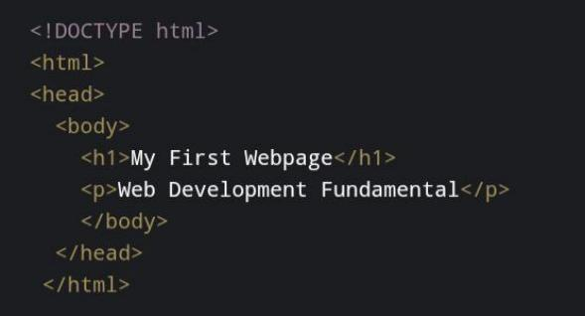
STRUCTURE OF HTML:
r The HTML document must start with a document type declaration <! DOCTYPE>
r The HTML document itself begins with <html> and ends With</html>
r The visible part of the html document is between <body> and</body>
Example:

Slide 6
CSS
NTRODUCTION:
r Css is the language we use to style a webpage.
r Css stands for Cascading style sheets.
r Css describeshow HTML element are to be displayed on screen, paper, or in other media.
r Css save a lot of work. If can control the layout of multiple web page all at once.
r External stylesheet are stored in css files.

Slide 7
SYNTAX:
r Selected css rule consists of a selector and a declaration
black.
h1
{ Color: red;
fout-size: 12 px;
}
EXPLAINED:
h1 is a selected in css.
Color is property, and red is value.
fout-size is property, and 12 px is values.

Slide 8
STYLING EXAMPLE:
<!DOCTYPE html>
<html>
<head>
<style>
h1
{
color: red;
text-align: center;
}
p{
color:blue;
text-align: center;
}
</style>
</head>
<body>
<h1>My First Browser</h1>
<p>The Browser useing appreciate Proussing</p>
</body>
</html>

Slide 9
JAVASCRIPT
NRODUCTION:
r Javascript is the programming language of the web.
r It can update and change both HTML and CSS.
r It can calculate, manipulate and validate data.

Slide 10
FEATURES OF JAVASCRIPT:
r Scripting Language.
r Interpreter Based.
r Event Handling.
r Object-based scripting language.
r Case-sensitive.
r In-build Function.
r Control Statement.
r Looping Statement.

Slide 11
SIMPLE PROGRAM:
<script>
function myFunction()
{
alertk(“helloworld”)
}
</script>
<body>
<p><button onclick=“myFunction ()”>Create a Dialog box</button></p>
<p><button onclick=“myFunction () “>Create another Dialog box</button></p>
</body>

Slide 12
USES:
r Websites.
r Web and Mobile Apps.
r Desktop Apps.
r Game Development.
r Single Page Application.
r Data Visualization.
r AI Apps.
r Interactive UX.
JavaScript is using to active of website Function work.

Slide 13

COMPARISON OF HTML, CSS,
JAVASCRIPT
The Html, css and
javascript are Using to
creating a website and web application, The web application are
using day to life.

Slide 14

REAL-TIME APPLICATION
r The modern Would provide “AI
APPLICATION”.
r The ai application
providing multiple ai
tools in the user

Slide 15


CONCLUSION
Web Development is the backbone of creating interactive and user-friendly websites.
HTML provides the structure, CSS enhances the design, and JavaScript adds interactivity.
Together, they form the foundation of modern front-end web development.
Understanding these technologies is essential for building real-world applications like e-commerce sites, social media platforms, and web apps.
In short: HTML = Content, CSS = Style, JavaScript = Behavior.
r
r r
r r r r
r r

Slide 16


